Slide 1
Library Management System
CSE23CL105 – Object Oriented Programming with Java Laboratory
~SUBMITTED BY
HARIGANESH.V-E0524007
LAKSHA.M-E0524012
HEMALAKSHMI.S-E0524015
GANESH SRINIVASAN-E0524016

Slide 2
INTRODUCTION
A console-based library system for adding, viewing, issuing, returning, and paying fees for books. Uses a text file for persistence (book.text).Categorizes by genres
Fantasy
Romance
Mystery/Thriller
Science Fiction
Historical Fiction
Horror
Humor
Each book has:
Title
Fee
Genre
Status
Fee Status
Issue Time
Main menu includes: Add Book, View Books, Pick a Book, Pay Fee, Return Book, Exit.

Slide 3
MOTIVATION,PROBLEM STATEMENT & OBJECTIVES
Motivation
Manual library processes are inefficient. This project automates them, improving experience and acting as a learning project for Java (file I/O, collections, string handling).
Problem Statement
Manual book tracking in small libraries is error-prone and inefficient. This system improves efficiency using automation and persistent data storage.
Objectives
Automate basic operations: Add, Issue, Return, Pay Fees
Organize by genre
Save data persistently
Educational tool for learning Java OOP

Slide 4
TECHNIQUES USED
OOP with a Book class
File handling with book.txt
ArrayList to store books
Reusable methods: addBook(), viewBooks(), etc.
Conditional logic with if-else
switch-case for menu
for loops for data iteration
Maps for genre classification

Slide 5
METHODOLOGY
Java OOP: Book class and SimpleLibrary class
Stores: Title, Fee, Genre, Issue Status, Fee Paid, Issue Time
Features:
Add Book
View Books (by genre, status, fee paid)
Pick a Book (issue)
Pay Fee
Return Book (resets data)
Exit (saves data)
File check and loading on start
Predefined genres with sample books
Persistent storage in book.txt

Slide 6
IMPLEMENTATION and RESULTS
CODE:
import java.io.*;
import java.util.*;
class Book { String title;
double fee;
boolean isIssued;
boolean isFeePaid;
long issueTime;
String genre;
public Book(String title, double fee, String genre)
{ this.title = title;
this.fee = fee;
this.genre = genre;
this.isIssued = false;
this.isFeePaid = false;
this.issueTime = 0; }

Slide 7
public Book(String[] parts)
{ this.title = parts[0];
this.fee = Double.parseDouble(parts[1]);
this.genre = parts[2];
this.isIssued = Boolean.parseBoolean(parts[3]);
this.isFeePaid = Boolean.parseBoolean(parts[4]);
this.issueTime = Long.parseLong(parts[5]);
} public String toFileString()
{ return title + "," + fee + "," + genre + "," + isIssued + "," + isFeePaid + "," + issueTime; }
@Override
public String toString() {
return title + " | " + fee + " | " + (isIssued ? "Issued" : "Available")
+ " | Fee Paid: " + (isFeePaid ? "Yes" : "No");
} } public class SimpleLibrary

Slide 8
{ static Scanner sc = new Scanner(System.in);
static List books = new ArrayList<>();
static final String FILE_NAME = "book.txt";
static final Map> genreSamples = Map.of(
"FANTASY", List.of("Harry Potter", "The Hobbit", "The Name of the Wind", "Mistborn",
"Eragon"),
"ROMANCE", List.of("Pride and Prejudice", "Me Before You", "The Notebook", "Outlander",
"The Time Traveler's Wife"),
"MYSTERY/THRILLER", List.of("Gone Girl", "The Girl with the Dragon Tattoo", "Sherlock Holmes",
"The Da Vinci Code", "The Silent Patient"),
"SCIENCE FICTION", List.of("Dune", "Ender's Game", "Neuromancer", "The Martian", "Foundation"),
"HISTORICAL FICTION", List.of("All the Light We Cannot See", "The Book Thief", "Wolf Hall",
"The Pillars of the Earth", "Memoirs of a Geisha"),
"HORROR", List.of("It", "The Shining", "Dracula", "Bird Box", "The Haunting of Hill House"),
"HUMOR", List.of("Good Omens", "The Hitchhiker's Guide to the Galaxy", "Bossypants", "Yes Please", "Diary of a Wimpy Kid") );
public static void main(String[] args)
{ loadBooksFromFile();

Slide 9
while (true) { System.out.println("\n--- Library Menu ---");
System.out.println("1. Add Book");
System.out.println("2. View Books");
System.out.println("3. Pick a Book");
System.out.println("4. Pay Fee");
System.out.println("5. Return Book");
System.out.println("6. Exit");
System.out.print("Enter your choice: ");
int choice = sc.nextInt(); sc.nextLine();
// consume newline switch (choice)
{ case 1 -> addBook();
case 2 -> viewBooks();
case 3 -> pickBook();
case 4 -> payFee();
case 5 -> returnBook();
case 6 -> { saveBooksToFile();
System.out.println("Exiting... Goodbye!");
return; }

Slide 10
default -> System.out.println("Invalid choice.");
}
}
} static void addBook()
{ System.out.print("Enter book title: ");
String title = sc.nextLine();
System.out.print("Enter book fee: ");
double fee = sc.nextDouble();
sc.nextLine();
System.out.print("Enter book genre: ");
String genre = sc.nextLine().toUpperCase();
books.add(new Book(title, fee, genre));
saveBooksToFile();
System.out.println("Book added successfully.");
} static void viewBooks()
{ if (books.isEmpty())
{ System.out.println("No books available.");
return;
}

Slide 11
System.out.println("\nBooks in Library:");
Map> grouped = new LinkedHashMap<>();
for (Book book : books)
{ grouped.computeIfAbsent(book.genre, k -> new ArrayList<>()).add(book);
} int count = 1;
for (String genre : genreSamples.keySet())
{ System.out.println("\n[" + genre + "]");
List genreBooks = grouped.getOrDefault(genre, new ArrayList<>());
if (genreBooks.isEmpty())
{ System.out.println(" No books available.");
} else
{ for
(Book b : genreBooks)
{ System.out.println(" " + (count++) + ". " + b);
}
}
}
}

Slide 12
static List getBooksByGenre(String genre)
{ List genreBooks = new ArrayList<>();
for (Book book : books)
{ if (book.genre.equalsIgnoreCase(genre))
{ genreBooks.add(book); }
} return genreBooks;
}
static void pickBook()
{ System.out.print("Enter genre: ");
String genre = sc.nextLine().toUpperCase();
List genreBooks = getBooksByGenre(genre);
if (genreBooks.isEmpty())
{ System.out.println("No books available in this genre.");
return; }
System.out.println("\nBooks in " + genre + ":");
for (int i = 0; i < genreBooks.size(); i++)
{ System.out.println(" " + (i + 1) + ". " + genreBooks.get(i));
}

Slide 13
System.out.print("Enter book number to pick: ");
int index = sc.nextInt() - 1;
sc.nextLine();
if (index >= 0 && index < genreBooks.size())
{ Book book = genreBooks.get(index);
if (!book.isIssued) { book.isIssued = true;
book.issueTime = System.currentTimeMillis();
saveBooksToFile();
System.out.println("Book issued successfully.");
} else
{ System.out.println("Book is already issued.");
}
} else
{ System.out.println("Invalid book number.");
}
}

Slide 14
static void payFee()
{ System.out.print("Enter genre: ");
String genre = sc.nextLine().toUpperCase();
List genreBooks = getBooksByGenre(genre);
if (genreBooks.isEmpty())
{ System.out.println("No books available in this genre.");
return; }
System.out.println("\nBooks in " + genre + ":");
for (int i = 0; i < genreBooks.size(); i++)
{ System.out.println(" " + (i + 1) + ". " + genreBooks.get(i));
} System.out.print("Enter book number to pay fee: ");
int index = sc.nextInt() - 1;
sc.nextLine();
if (index >= 0 && index < genreBooks.size())
{ Book book = genreBooks.get(index);
if (!book.isFeePaid) { book.isFeePaid = true;
saveBooksToFile();

Slide 15
System.out.println("Fee " + book.fee + " paid for: " + book.title);
} else { System.out.println("Fee already paid.");
}
} else { System.out.println("Invalid book number.");
}
} static void returnBook()
{ System.out.print("Enter genre: ");
String genre = sc.nextLine().toUpperCase();
List genreBooks = getBooksByGenre(genre);
if (genreBooks.isEmpty())
{ System.out.println("No books available in this genre.");
return; }
System.out.println("\nBooks in " + genre + ":");
for (int i = 0; i < genreBooks.size(); i++)
{ System.out.println(" " + (i + 1) + ". " + genreBooks.get(i));
}

Slide 16
System.out.print("Enter book number to return: ");
int index = sc.nextInt() - 1;
sc.nextLine();
if (index >= 0 && index < genreBooks.size())
{ Book book = genreBooks.get(index);
if (book.isIssued)
{ book.isIssued = false;
book.isFeePaid = false;
book.issueTime = 0;
saveBooksToFile();
System.out.println("Book returned successfully.");
} else
{ System.out.println("Book is not issued.");
}
} else
}

Slide 17
{ System.out.println("Invalid book number.");
}
static void saveBooksToFile()
{ try (PrintWriter writer = new PrintWriter(new FileWriter(FILE_NAME)))
{ for (Book book : books)
{ writer.println(book.toFileString());
}
} catch (IOException e)
{ System.out.println("Error saving books: " + e.getMessage());
}
} static void loadBooksFromFile()
{ File file = new File(FILE_NAME);
if (!file.exists())
{ for (Map.Entry> entry : genreSamples.entrySet())
{ for (String title : entry.getValue())
{ books.add(new Book(title, 200, entry.getKey()));
}
}

Slide 18
saveBooksToFile();
return;
} try
(BufferedReader reader = new BufferedReader(new FileReader(FILE_NAME)))
{ String line;
while ((line = reader.readLine()) != null)
{ books.add(new Book(line.split(",")));
}
} catch (IOException e)
{ System.out.println("Error loading books: " + e.getMessage());
}
}
}

Slide 19
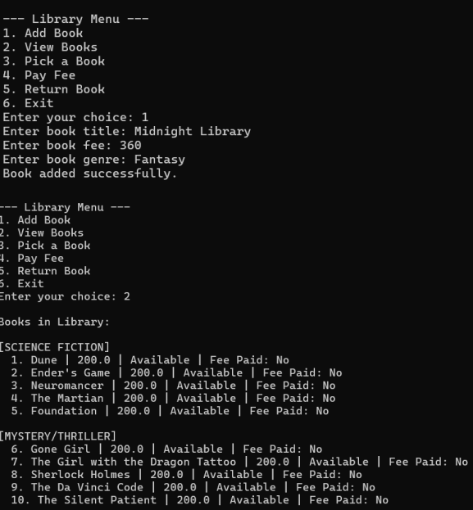
OUTPUTS:

Slide 20
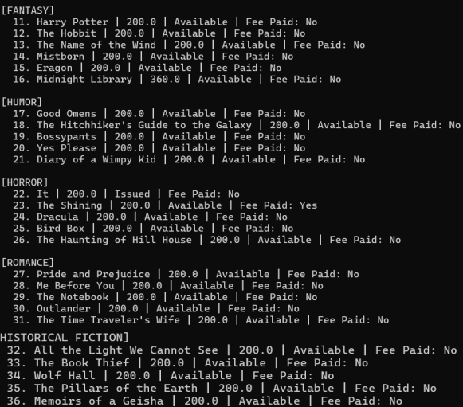

Slide 21
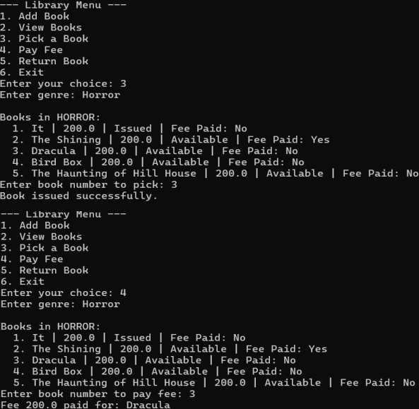

Slide 22
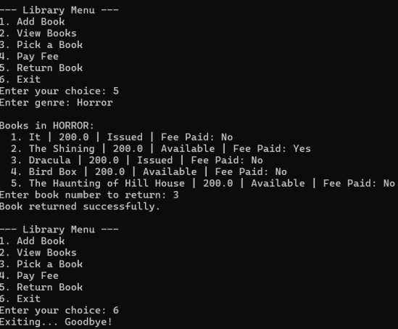

Slide 23
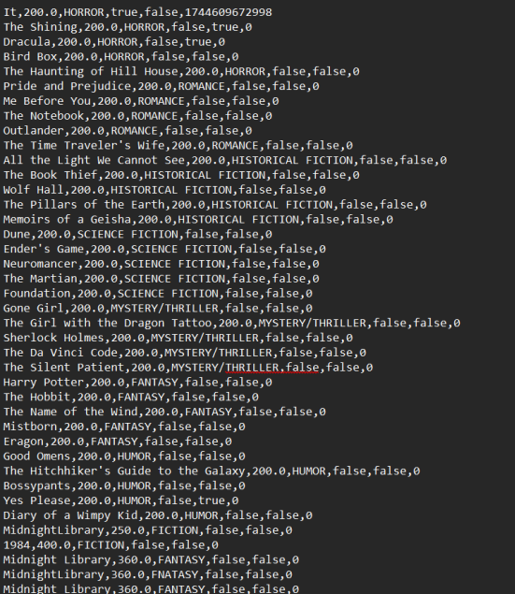

Slide 24
CONCLUSION & FUTURE WORK
The ultimate goal of the project is to design and implement console-based Library Management System that efficiently handles the addition, organization, issuing, fee management, and return of books, while ensuring data persistence and console-based Library Management System that efficiently handles the addition, organization, issuing, fee management, and return of books, while ensuring data persistence and providing for administrators and users.
In Future, the proposed system can be enhanced further to improve functionality and usability. One of the key improvements would be integrating the system with a database to handle larger volumes of data more efficiently and ensure better data security.
A Graphical User Interface (GUI) using Swing can also be implemented to make the system more for non-technical users. The Simple Library Management System is a basic but useful program that helps users manage books in a small library. It allows adding new books, viewing them by genre, issuing and returning books, and handling fee payments. All book data is stored in a file, so it can be reused every time the program runs. This system is easy to use and serves as a good starting point for building more advanced library software.

Slide 25
REFERENCES
1. Horstmann, C. S., & Cornell, G. (2013).
Core Java Volume I–Fundamentals (10th ed.). Prentice Hall.
2. Schildt, H. (2018).
Java: The Complete Reference (11th ed.). McGraw-Hill Education.
3. Liberty, J. (2015).
Programming Java for Beginners. O'Reilly Media.
4. Deitel, P. J., & Deitel, H. M. (2017).
Java How to Program (11th ed.). Pearson Education.
5. Hughes, R., & Hughes, R. W. (2002).
Software Design and Development Using Java. Addison-Wesley.
6. Singh, R. (2021).
Library Management System Using Java. Independently Published.

